Slide 1
FOOD PREPARATION & SERVICE
ROLES AND STYLES OF SERVICE

Slide 2
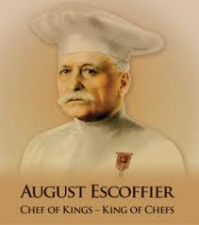
BRIGADE SYSTEM
AUGUSTE ESCOFFIER CREDITED WITH THIS ORGANIZATIONAL SYSTEM OF KITCHEN ROLES BY FOOD PREPARATION OR SPECIALTY.
MODERNIZED COURSES
A LA CARTE
ORDERED SERVICE
MISE EN PLACE
COOKING AS AN ART

Slide 3
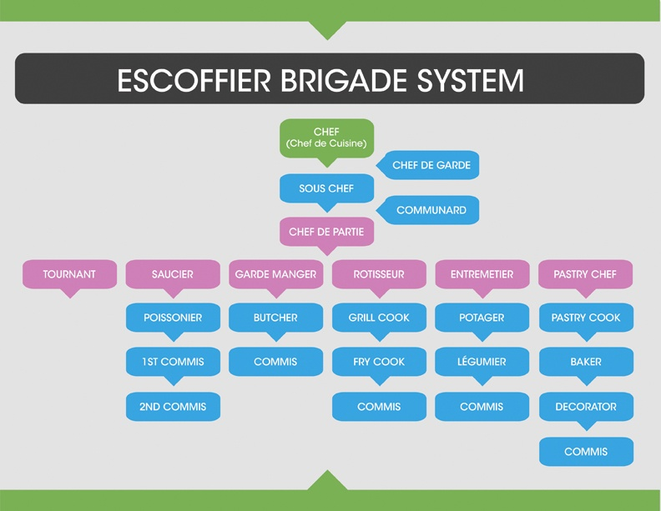

Slide 4
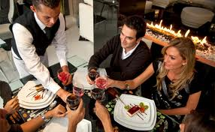
BASICS OF TABLE SERVICE
SERVE FROM THE LEFT
REMOVE FROM THE RIGHT
BEVERAGES ARE SERVED FROM THE RIGHT
SERVE WOMEN FIRST AND BY AGE
DO NOT ALLOW FINGERS TO TOUCH FOOD
SERVE GLASSWARE BY THE BOTTOM OR STEM
DELIVER SILVER GLASS WITH TRAYS

Slide 5
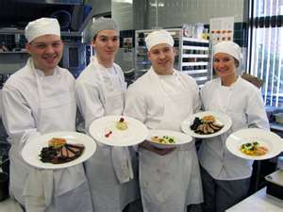
TYPES OF SERVICE
AMERICAN
FRENCH
ENGLISH
RUSSIAN
BUFFET
SYNCRONIZED (SWEEP)

Slide 6
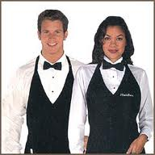
ROLES
BOH
STEWARD
SOMMELIER
EXECUTIVE CHEF
SOUS CHEF
APPRENTICE
PASTRY CHEF
GARDE MANGER
FOH
SERVERS
BUSPERSON
CAPTAIN
MAITRE D’HOTEL
FOOD RUNNERS

Slide 7
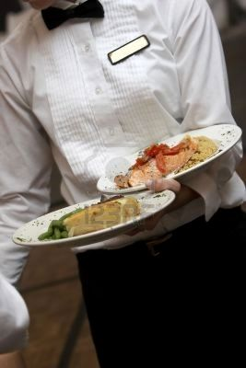
AMERICAN
Each course is individually plated
Often for sit-down banquets
Portions food consistently
Serves guests efficiently
and timely

Slide 8
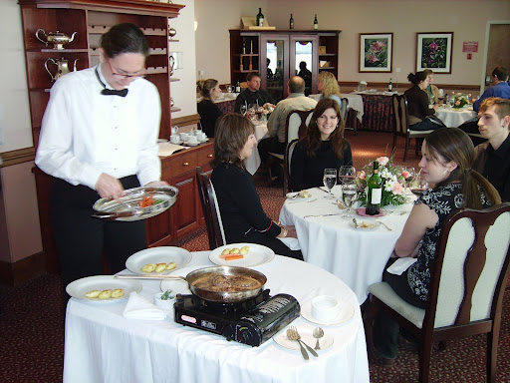
FRENCH
Consists of teams of service personnel
Front waiter cooks and plates dishes tableside in front of guests
Typically done from a cart called a gueridon equipped with burners
Very costly, often used with other types of service

Slide 9
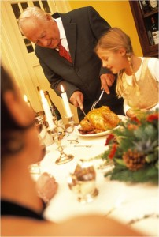
ENGLISH
Food is served on a large platter in front of the host with enough food for guests seated at designated table
A host/hostess then serves the food plating each guest’s portion individually
Promotes authority or respect for the host.
Suitable for an event where there are subordinates dining alongside executives, etc.

Slide 10
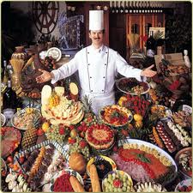
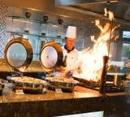
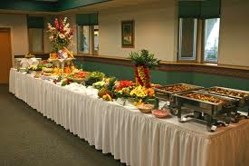
BUFFET-CENTRALIZED TABLES WITH VARIOUS FOOD CHOICES
STANDARD
Lower costs
Requires less servers
Guests serve themselves
INTERACTIVE
Higher profit
Food is plated & customized
More controlled food cost

Slide 11
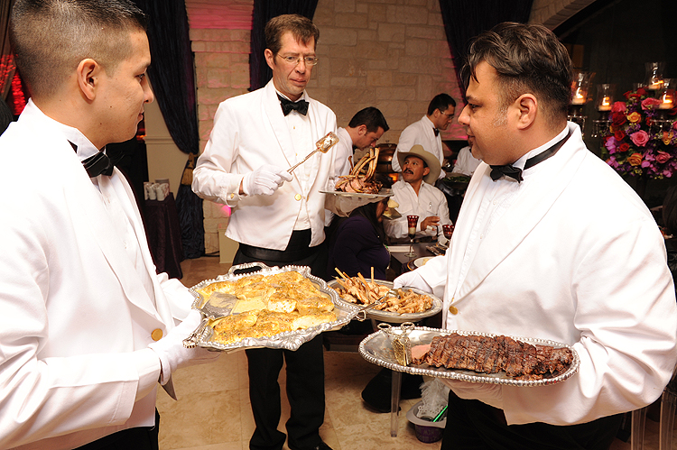
RUSSIAN
Food comes from the kitchen on elaborate silver platters
It is then served by waitstaff individually portioning food onto the guest’s plate
Individual servers can have separate elements to the meal
Time consuming
Considered formal “white glove”
Plates are customarily warmed or chilled prior

Slide 12
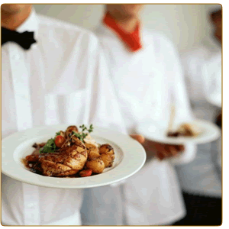
BUTLER
Also known as passed service
Guests serve themselves from a platter
Very common during cocktail hour to serve hors d’oeuvres in this manner
Napkins and toothpicks are carried by server

Slide 13
SWEEP SERVICE
SERVERS DELIVER OR UNVEIL PLATES SIMULTANEOUSLY
MAY HAVE COVERS OR CLOCHES
ENSURES GUESTS EAT TOGETHER
2 PLATES TO EACH SERVER
One plate presented, then transfer, then 2nd is presented
HOW MANY SERVERS WOULD YOU NEED FOR A TABLE OF 10?

Slide 14
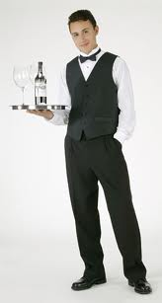
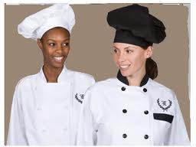
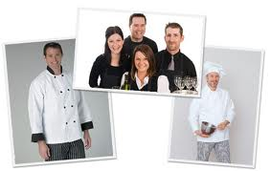
UNIFORMS
REQUIRED FOR BOH AND FOH STAFF
CHOSEN BASED ON FORMALITY AND SERVICE TYPE
CUSTOMARILY COMBINATIONS OF BLACK AND WHITE

Slide 15
ACTIVITY
WHAT TYPE OF SERVICE WOULD YOU SUGGEST TO A COST-CONSCIOUS CLIENT?
WHAT ABOUT AN EVENT WITH ONLY 25 GUESTS?
A HIGH-END CLIENT?
MAKE NOTES ON UNIFORMS & SERVICE TYPES

